Slide 1

Fuzzy Sets
BY: NICHOLAS DIGIOIA-CELENTANO

Slide 2


Sets: A Basic Understanding
SETS
FUZZY
CLASSIC
𝜇A(u) is the membership function

Slide 3
Some Facts About Fuzzy Sets
Fuzzy sets were introduced by Lofti A. Zadeh in 1965 as an extension of the classic set
The term “fuzzy” in this context is when the boundaries of the information is not so cut and dry. They’re ambiguous/vague
This is something the usual classic set cannot handle
How do we solve this problem? We assign the data different degrees of membership, represented by 𝜇

Slide 4
But Why Use Fuzzy Sets?
Classic sets allow for a piece of data to be a member of a set in binary terms
You’re either on or off, true or false, 1 or 0, in the set or not
Fuzzy sets allow for a piece of data to be between these classic boundaries
What if something is between 1 and 0? Not completely true or false?

Slide 5
How About an Example?
Yes/True/1
Is the water hot?
Boolean/Classic Logic
No/False/0
Very Hot /0.75 - 1
Pretty hot/0.5 - 0.75
Is the water hot?
Fuzzy Logic
A little hot/0.25 – 0.5
Not Hot/0 – 0.25

Slide 6
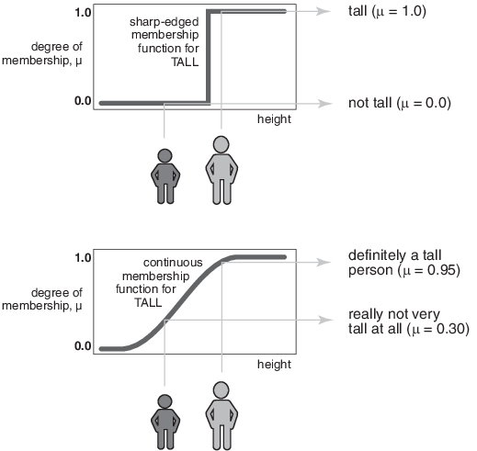
A More “Human” Example?

Slide 7
Why are Fuzzy Sets Important?
Classic sets and logic are great to use when something either IS or IS NOT. They are easier and less expensive to implement
But classic sets are not great at telling us exactly HOW related something is to something else in the set
Fuzzy sets in computer science allows us to make more “human” relations to these values. What if something is in between IS or IS NOT?
Fuzzy sets are also integral for AI purposes, allowing the AI to take a more human approach to problem solving, clustering, and sorting data

Slide 8
Q&A
Thank you all for listening!
Any questions?

Slide 9
Works Cited
https://en.wikipedia.org/wiki/Fuzzy_set
https://www.mathworks.com/help/fuzzy/foundations-of-fuzzy-logic.html

